Slide 1

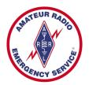
Training Volunteers
The ARRL
Introduction to Emergency Communication Course
EC-001 (2011)
Session Four
Notes:
Make sure you have modified the Name and Date.
Display this screen as students are arriving for class.

Slide 2
W e l c o m e B a c k

Slide 3
Reminder
Complete two DHS/FEMA Courses
IS-100.b Introduction to ICS
IS-700 National Incident Management System
Http://training.fema.gov/IS/NIMS.asp
Notes:
ARRL conditions!
The two ICS courses must be complete before taking the final exam.

Slide 4
Session Four Topic
Session 1 – Topics 1, 2, 3, 4, 5a, 5b
Session 2 – Topics 6, 7a, 7b, 7c, 7d, 8, 9, 10
Session 3 – Topics 11, 12, 13, 14, 15
Session 4 – Topics 16, 17, 18, 19, 20
Session 5 – Topics 21, 22, 23, 24, 25, 26, 27
Session 6 – Topics 28, 29, Summary, Final Exam
Notes:
The course requires a total of 18 hours.
If a student misses one class they can take a practice quiz for each lesson missed.
A student missing two sessions will be asked to take the course again.
A student missing the last session must wait for the next class and attend the final session for taking the exam again.
An exception would be two Field Examiners agreeing to give the exam at a mutually scheduled time.

Slide 5
Topic 16 – The Incident Command System (ICS)

Slide 6
The Beginnings
Major California wild fires
Multi-agencies
Coordination and cooperation
Poor overall organization
Firefighting Resources of California Organized for Potential Emergencies (FIRESCOPE)
Formed in early 1970s
National Fire Academy (NFA)
Developed the ICS
Notes:
California authorities had found that a lack of coordination and cooperation between the various responding agencies resulted in over-lapping efforts, and gaps in the overall response. Many specific problems involving multi-agency responses were identified by FIRESCOPE. These included poor overall organization, ineffective communication between agencies, lack of accountability, and the lack of a single, universal, and well-defined command structure.
Although developed for wild land fires, the system ultimately evolved into an "all-risk" system, appropriate for all types of fire and non-fire emergencies.
There are other versions of the ICS in use, but the Incident Command System (ICS), as developed by the National Fire Academy (NFA), has been widely recognized as a model tool for the command, control, and coordination of resources and personnel at the scene of an emergency and is used by most fire, police, and other agencies around the country. The use of the ICS is now required by various federal laws for all hazardous material incidents, and in other situations by many state and local laws. The ICS has also been adopted for use in many other countries.

Slide 7
National Incident Management System (NIMS)
A systematic proactive approach
Guide departments and agencies at all levels of government, non-government and private sector
National Response Framework (NRF)
NIMS provides the template
NRF provides the structure and mechanisms
ICS provides the accountability
Notes:
California authorities had found that a lack of coordination and cooperation between the various responding agencies resulted in over-lapping efforts, and gaps in the overall response. Many specific problems involving multi-agency responses were identified by FIRESCOPE. These included poor overall organization, ineffective communication between agencies, lack of accountability, and the lack of a single, universal, and well-defined command structure.
Although developed for wild land fires, the system ultimately evolved into an "all-risk" system, appropriate for all types of fire and non-fire emergencies.
There are other versions of the ICS in use, but the Incident Command System (ICS), as developed by the National Fire Academy (NFA), has been widely recognized as a model tool for the command, control, and coordination of resources and personnel at the scene of an emergency and is used by most fire, police, and other agencies around the country. The use of the ICS is now required by various federal laws for all hazardous material incidents, and in other situations by many state and local laws. The ICS has also been adopted for use in many other countries.

Slide 8
What is ICS?
Management tool designed to bring multiple responding agencies, including those from different jurisdictions, together under a single overall command structure
Based upon simple and proven business management principles
Managers and leaders perform the basic daily tasks of planning, directing, organizing, coordinating, communicating, delegating, and evaluating

Slide 9
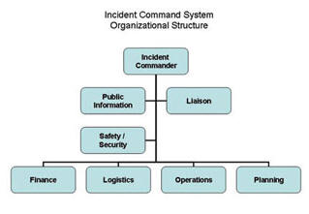
What is ICS?
Functional areas
Performed under the overall direction of a single Incident Commander (IC) in a coordinated manner, even with multiple agencies and across jurisdictional lines

Slide 10
What the ICS is not
Fixed and unchangeable
A means to take control or authority
A way to subvert the normal chain of command
Always managed by the fire department - or the first agency to arrive on-scene..
Too big and cumbersome to be used in small, everyday events.
Restricted to use by government agencies and departments.

Slide 11
The ICS Structure
ICS has two interrelated parts
Management by objectives
Understand the policies, procedures, and statutes that affect the official response
Establish incident objectives
Select appropriate strategies for cooperation and resource utilization
Apply tactics most likely to accomplish objectives
Organizational Structure
Notes:
The complexity of the incident will determine how formally the "management by objectives" portion will be handled. If the incident is small and uncomplicated, the process can be handled by verbal communication between appropriate people. As the incident and response become more complex, differences between the individual agencies' or departments' goals, objectives, and methods will need to be resolved in writing.

Slide 12
Organizational Structure
Flexible organizational structure that can be modified to meet changing conditions
One person in charge
"Incident Commander" (IC)
"General Staff"
Information, Safety, and Liaison Officers
Four major operating sections:
Planning, Operations, Logistics, Finance/Administration

Slide 13
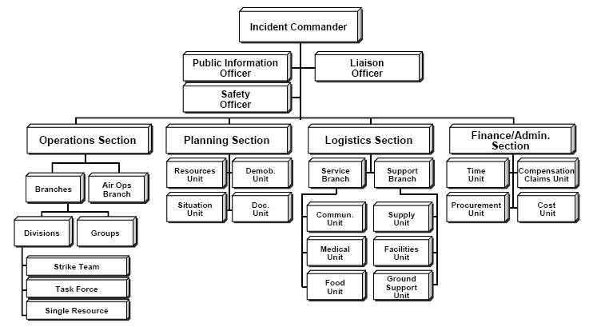
ICS

Slide 14
Incident Commander (IC)
Initial the IC is usually the most senior on-scene officer from the first responding agency
Management of the incident
Setting initial incident objectives
"Incident Plan" (IP)

Slide 15
How does an emcomm group "fit in" to the ICS
Involvement in any incident where ICS is used is by “invitation only”
There is no role for off-the-street volunteers
Relationship of an emcomm group to the ICS structure will vary with the specific situation
Your emcomm (ARES, RACES, etc.) group may have a representative on the Logistics Section's "communication task force"

Slide 16
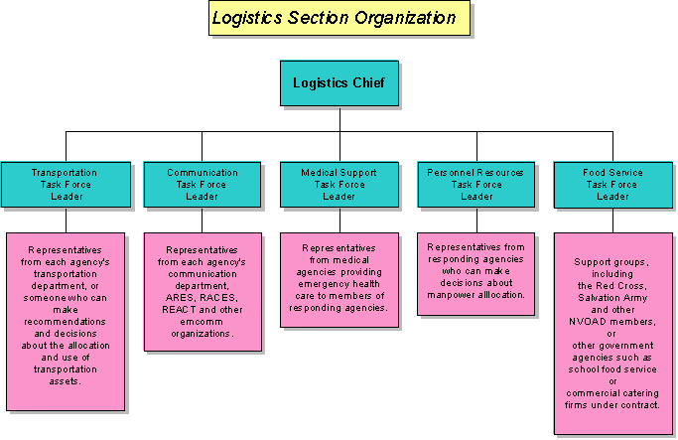

Slide 17
Summary
Any questions before the quiz?

Slide 18
Time for a Quiz
Take 30 Seconds adjust your workspace

Slide 19
30
Seconds

Slide 20
20
Seconds

Slide 21
10
Seconds

Slide 22
9
Seconds

Slide 23
8
Seconds

Slide 24
7
Seconds

Slide 25
6
Seconds

Slide 26
5
Seconds

Slide 27
4
Seconds

Slide 28
3
Seconds

Slide 29
2
Seconds

Slide 30
1
Seconds

Slide 31
Let's get started!

Slide 32
Topic 16 Question
What do the letters "ICS" stand for?
International Correspondence School
Incident Command System
Institutional Control System
Internal Control Sequence

Slide 33
Topic 16 Question
What is ICS?
A management tool for coordinating the resources of several agencies within a single command structure
A fixed and unchangeable system for managing an incident
A means of subverting the normal command structure within an agency or department
A management system restricted to use by government agencies and departments

Slide 34
Topic 16 Question
The ICS has two interrelated parts. What are they?
A mission statement and management objectives
Management by objectives and organizational structure
Organizational structure and a financial plan
A financial plan and an operational plan

Slide 35
Topic 16 Question
Aside from the Incident Commander, there are four other major operating sections within an ICS. What are they?
Planning, Operations, Logistics and Public Relations
Personnel, Planning, Operations and Finance/Administration
Planning, Operations, Logistics, and Finance/Administration
Payroll, Finance/Administration, Logistics and Operations

Slide 36
Topic 16 Question
What is an emcomm group's relationship to the ICS structure during an incident?
The emcomm group always serves within the Logistics area
The emcomm group may or may not be a formal part of the ICS structure
The emcomm group always serves the Task Force leader directly
The emcomm group always serves the Incident Commander directly

Slide 37
Any Questions Before Starting Topic 17?

